Slide 1
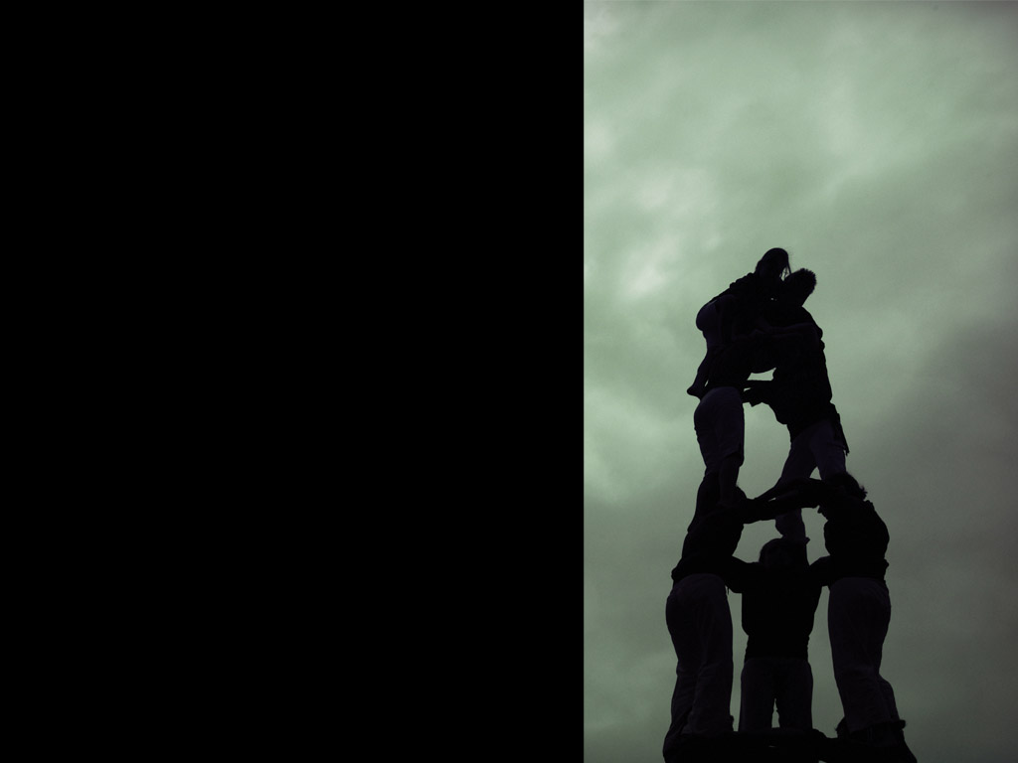
How To Lead and Grow a Healthy Small Group

Slide 2
SMALL GROUP DYNAMICS
Session One:
Keys to Healthy Small Groups

Slide 3
SMALL GROUP DYNAMICS
True or False?
“If a small group is full of Christians, it will automatically be healthy and grow."

Slide 4
SMALL GROUP DYNAMICS
Handout
(p. 40-43)
“ReGroup” Participant’s Guide
(Cloud, Donahue & Townsend/Zondervan)
“Determining Your Group’s Purpose”

Slide 5
SMALL GROUP DYNAMICS
Watch
(15 minutes)
“ReGroup” Disc 1
(Cloud, Donahue & Townsend/Zondervan)
Session Four – Determining Your Group’s Purposes
“Segment One: Determining Your Purpose”

Slide 6
SMALL GROUP DYNAMICS
Handout
(p. 55-58)
“ReGroup” Participant’s Guide
(Cloud, Donahue & Townsend/Zondervan)
“Tip Two: Being Attentive”

Slide 7
SMALL GROUP DYNAMICS
Watch
(5 minutes)
“ReGroup” Disc 2
(Cloud, Donahue & Townsend/Zondervan)
“Tip Two: Being Attentive”

Slide 8
Next Session:
The Group Leader and Shepherding

Slide 9
SMALL GROUP DYNAMICS
Session Two:
The Group Leader and Shepherding

Slide 10
SMALL GROUP DYNAMICS
Handout
(p. 24-27)
“ReGroup” Participant’s Guide
(Cloud, Donahue & Townsend/Zondervan)
“Five Habits of Life-Changing Groups”

Slide 11
SMALL GROUP DYNAMICS
Watch
(23 minutes)
“ReGroup” Disc 1
(Cloud, Donahue & Townsend/Zondervan)
Session Two – Five Habits of Life-Changing Groups
“Segment One: The Five Essential Habits”

Slide 12
SMALL GROUP DYNAMICS
Input
(15 mins)
Four Key Skills for Small Groups Leaders
Build a Leadership Team
Conduct Life-Changing Group Meetings
Shepherd the Members of Your Group
Expand the Ministry
“Leading Life Changing Small Groups”
Donahue (Zondervan, 1996)

Slide 13
SMALL GROUP DYNAMICS
Input
Build a Leadership Team
Reflect on God’s calling on your life
Choose a person to mentor as you lead your group
Find a host and a venue
Equip yourself spiritually and with skills

Slide 14
SMALL GROUP DYNAMICS
Input
Conduct Life-Changing Group Meetings
Identify who will be in your group
Select your material
Share the responsibility
Report your progress

Slide 15
SMALL GROUP DYNAMICS
Input
Shepherd the Members of Your Group
Pray for your meeting and your group
Exercise oversight of your group
Model Christ-likeness to your group
Be vulnerable

Slide 16
SMALL GROUP DYNAMICS
Input
Expand the ministry
Use the open chair to invite others
Encourage a healthy relationship with the church
Assign to your apprentice people to shepherd

Slide 17
SMALL GROUP DYNAMICS
Watch
(15 minutes)
“An Hour On Sunday”
Highlights
(Willow Creek Australia)
Part 2: “The Wonder of a Quieted Soul”
Drama and Song

